Slide 1
Topic 9 – Recursion

Slide 2
Recursive methods
When a method is called the program goes off and runs it
Consider the following method…
public static void sayHello() {
System.out.println(“Hello World!”);
sayHello();
}
What will happen?

Slide 3
Recursive methods
As you’d expect,
the main method calls sayHello(), which prints out “Hello World!” and
calls sayHello(), which prints out “Hello World!” and
calls sayHello(), which prints out “Hello World!” and
calls sayHello(), which prints out “Hello World!” and
calls sayHello(), which prints out “Hello World!” and
calls sayHello(), which prints out “Hello World!” and
calls sayHello(), which prints out “Hello World!” and
calls sayHello(), which prints out “Hello World!” and
calls sayHello(), which prints out “Hello World!” and
…
all of a sudden the program crashes!

Slide 4
Recursion
Recursion is when a method calls itself
It is used when a complicated problem can be broken down into a simpler problem of the same type
In that case you can just call the same method on the simpler problems and use the results to solve the bigger problem

Slide 5
Iterative example
This program figures out the factorial of a number using an ordinary loop
factorial(5) = 1 x 2 x 3 x 4 x 5 = 120
public static int factorial( int N ) {
int product = 1;
for ( int j = 1; j <= N; j++ )
product = product * j;
return product;
}
// for loop
// run several times

Slide 6
Recursive example
This program does exactly the same thing but cleverly calls itself
It can do this because factorial(5) = factorial(4) x 5 and factorial(4) = factorial(3) x 4
Figure out the answer to the smaller problem first and use this to figure out the answer to the bigger problem
public static int factorial( int N ) {
return N * factorial( N-1 ) ;
}
// for loop
for ( int j = 1; j <= N; j++ )
product = product * j;

Slide 7
Base case
There’s a flaw with the previous piece of code
The problem is that it goes on forever
We need to get it to stop at some point
In order to stop, all recursive methods must have base case where the answer is known automatically without calling another recursive method
public static int factorial( int N ) {
return N * factorial( N-1 ) ;
}
// It won't stop

Slide 8
Base case
The answer to factorial(1) will always be 1
We can set this as the base case using an if statement
public static int factorial( int N ) {
if ( N == 1 )
return 1;
else
return N * factorial( N-1 );
}
// Base case
// It will stop when N == 1

Slide 9
Recursive example
So, let us to calculate factorial(5):
factorial(5)
= 5 x factorial(4)
= 5 x ( 4 x factorial(3) )
= 5 x ( 4 x ( 3 x factorial(2) ))
= 5 x ( 4 x ( 3 x ( 2 x factorial(1) )))
= 5 x ( 4 x ( 3 x ( 2 x 1 )))
= 5 x ( 4 x ( 3 x 2) )
= 5 x ( 4 x 6 )
= 5 x 24
= 120

Slide 10
Recursion
The method keeps calling itself until it reaches the base case and then it filters back up
Recursion can be used to simplify a problem conceptually
It also reduces the amount of code needed
The characteristics of a recursive method are
It calls itself
When it calls itself, it does so to solve a smaller problem
There’s some version of the problem that is simple enough that the routine can solve it and return without calling itself

Slide 11
Example
How can we find the n-th term of this sequence?
[ 1 3 6 10 15 21 … ]
Each time the n-th term is obtained by adding n to the term before
The numbers are called triangular numbers because they can be visualized as a triangular arrangement of numbers
The 3rd term is the total number of items in three rows etc.
n = 1
n = 2
n = 3
n = 4

Slide 12
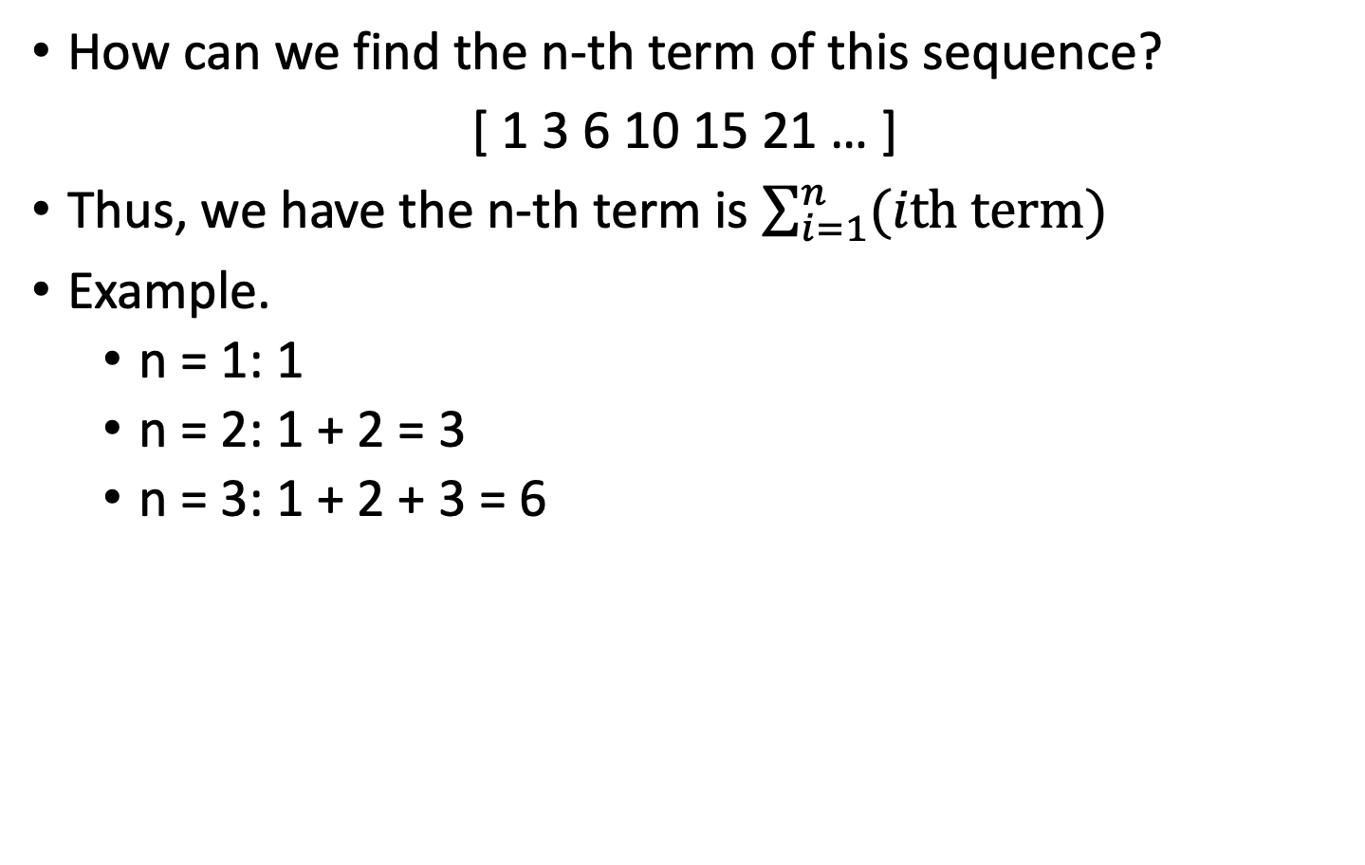
Example
How can we find the n-th term of this sequence?
[ 1 3 6 10 15 21 … ]
Thus, we have the n-th term is $\sum_{i=1}^{n}{(ith term)}$
Example.
n = 1: 1
n = 2: 1 + 2 = 3
n = 3: 1 + 2 + 3 = 6
n = 1
n = 2
n = 3
n = 4

Slide 13
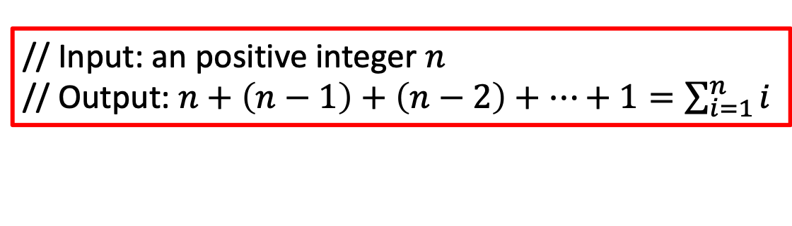
Example
Say we want to get the fourth term we have to add
4 +3 +2 + 1 = 10
We can do this with a while loop:
public static int triangle (int n) {
int total = 0;
while(n > 0) {
total = total + n;
n--;
}
return total;
}
You can write as…
====================
for (int i = n; i>0; i--) {
total = total + i;
}
// Input: an positive integer $n$
// Output: $n+\left(n−1\right)+\left(n−2\right)+…+1=\sum_{i=1}^{n}{i}$

Slide 14
Algorithm
Therefore the following is true:
pins in N rows = pins in row N + pins in N-1 rows
Here is the algorithm for recursive triangular numbers:
Triangle( 1 ) = 1
Triangle( N ) = N + Triangle( N - 1 )
n = 1
n = 2
n = 3
n = 4
n = 5

Slide 15
Example
So, let us to calculate triangle(5):
triangle(5)
= 5 + triangle (4)
= 5 + ( 4 + triangle (3) )
= 5 + ( 4 + ( 3 + triangle (2) ))
= 5 + ( 4 + ( 3 + ( 2 + triangle (1) )))
= 5 + ( 4 + ( 3 + ( 2 + 1 )))
= 5 + ( 4 + ( 3 + 3) )
= 5 + ( 4 + 6 )
= 5 + 10
= 15

Slide 16

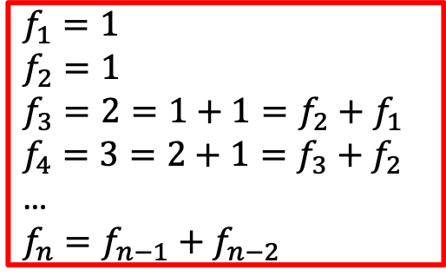
Fibonacci Series
The Fibonacci series is as follows:
1, 1, 2, 3, 5, 8, 13…
Each term is calculated by the sum of the two terms before it
public static long fibonacci(int n) {
if (n == 1) return 1;
if (n == 2) return 1;
return fibonacci(n-1) + fibonacci(n-2);
}
$f_{1}=1$
$f_{2}=1$
$f_{3}=2=1+1=f_{2}+f_{1}$
$f_{4}=3=2+1=f_{3}+f_{2}$
…
$f_{n}=f_{n−1}+f_{n−2}$

Slide 17
The Efficiency of Recursion
Recursive implementation of fib is straightforward
First few calls to fib are quite fast
For larger values, the program pauses an amazingly long time between outputs
It turns out that using recursion to compute Fibonacci numbers is terrible!!
Lesson: recursion can simplify code but is not always more efficient

Slide 18
Call tree for computing fib(6)

Slide 19
The efficiency of recursion
Method takes so long because every level doubles the number of recursive calls
The computation of fib(6) calls fib(3) three times and fib(2) five times!
A recursive method should not call itself more than once
If we want to use recursion, without exponential increase in number of method calls, we can use dynamic programing

Slide 20
Dynamic programming
Dynamic programming (also known as dynamic optimization) is a method for solving a complex problem by breaking it down into a collection of simpler subproblems, solving each of those subproblems just once, and storing their solutions

Slide 21
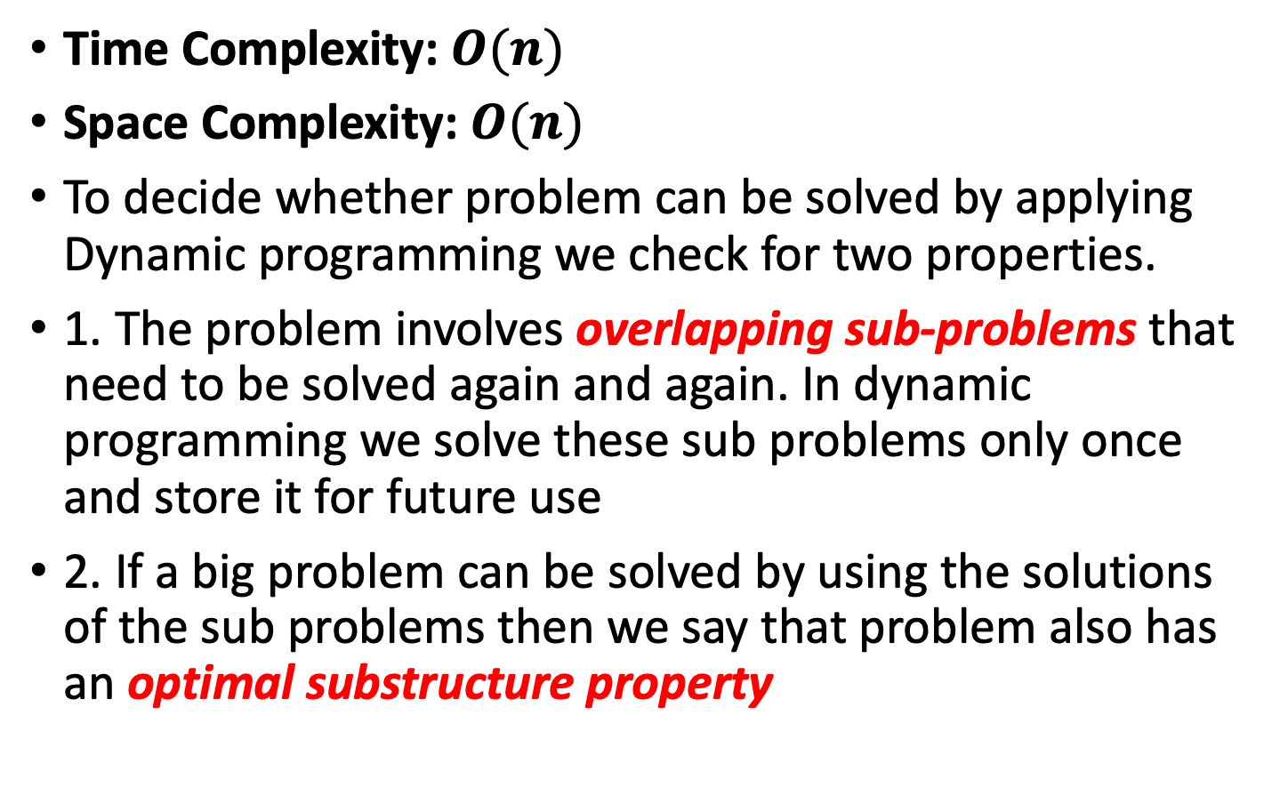
Dynamic programming
Time Complexity: $O(n)$
Space Complexity: $O(n)$
To decide whether problem can be solved by applying Dynamic programming we check for two properties.
1. The problem involves overlapping sub-problems that need to be solved again and again. In dynamic programming we solve these sub problems only once and store it for future use
2. If a big problem can be solved by using the solutions of the sub problems then we say that problem also has an optimal substructure property

Slide 22
Dynamic programming
Bottom-Up solution for Fibonacci Series:
public int fibBU(int x) {
int fib[] = new int[x + 1];
fib[0] = 0;
fib[1] = 1;
for (int i = 2; i < x + 1; i++) {
fib[i] = fib[i - 1] + fib[i - 2];
}
return fib[x];
}
// recursion

Slide 23
Dynamic programming
Top-Down recursive approach, involving filling up an array which lies outside the recursive method:
public int fibTD(int n) {
if(n == 0) return 1;
if(n == 1) return 1;
if(fib[n] != 0) {
return fib[n];
}
else {
fib[n] = fibTD(n-1) + fibTD(n-2);
return fib[n];
}
}

Slide 24
Remember Binary Search?
We keep dividing our search space and therefore need to keep track of the bounds
Upperbound
Lowerbound
If the number is bigger than 51 then 51 is the new lower bound
try this
lowerBound
upperBound
Data | 11 | 13 | 15 | … | 43 | 51 | 62 | … | 99
check = (lowerBound + upperBound ) / 2

Slide 25
Recursive Binary Search
The binary search for arrays keeps dividing the array in half and then selecting the half where the desired cell can be
Instead of using a loop as before, we can simply call the search function on the half of the array
The find method makes the initial call to search the whole array using recursive find
public int find(long searchKey) {
return recFind(searchKey, 0, nElems-1);
}

Slide 26
Recursive Binary Search
private int recFind(long searchKey, int lowerBound, int upperBound) {
int middle;
middle = (lowerBound + upperBound ) / 2;
if(a[middle] == searchKey) return middle; // found it
else if(lowerBound > upperBound) return -1; // can't find it
else { // divide range
if(a[middle] < searchKey) // it's in upper half
return recFind(searchKey, middle+1, upperBound);
else // it's in lower half
return recFind(searchKey, lowerBound, middle-1);
} // end else divide range
} // end recFind()

Slide 27
Recursive Binary Search Method
Call with lowerbound=0 upperbound=15
Lowerbound=0
Upperbound=15
Lowerbound=0
Upperbound=6
Lowerbound=0
Upperbound=2
Lowerbound=2
Uppperbound=2
Found it at 2
Return 2
Return 2
Return 2
Return 2
Return 2

Slide 28
Divide and Conquer
Recursive binary search is an example of the divide and conquer approach
The big problem is divided into two smaller problems and each one is solved separately
These are then divided into even smaller problems etc.
The process continues until you get to the base case which can be solved easily with no further division
The answer is then filtered back through all the recursive method calls

Slide 29
Towers of Hanoi
We need to move all the disc from the first pole to the third pole with the smallest disc at the top and the largest at the bottom under the below conditions
1. Only one disc can be moved at a time.
2. Larger disc cannot be placed on a smaller disc.

Slide 30
Towers of Hanoi
In the late Victorian era, a toy came out that was based on an idea of a French mathematician, Edouard Lucas. The toy consisted of a set of three rods and a set of discs
The idea is to move all the discs one at a time without ever placing a disc on top of a smaller one

Slide 31
Solution

Slide 32
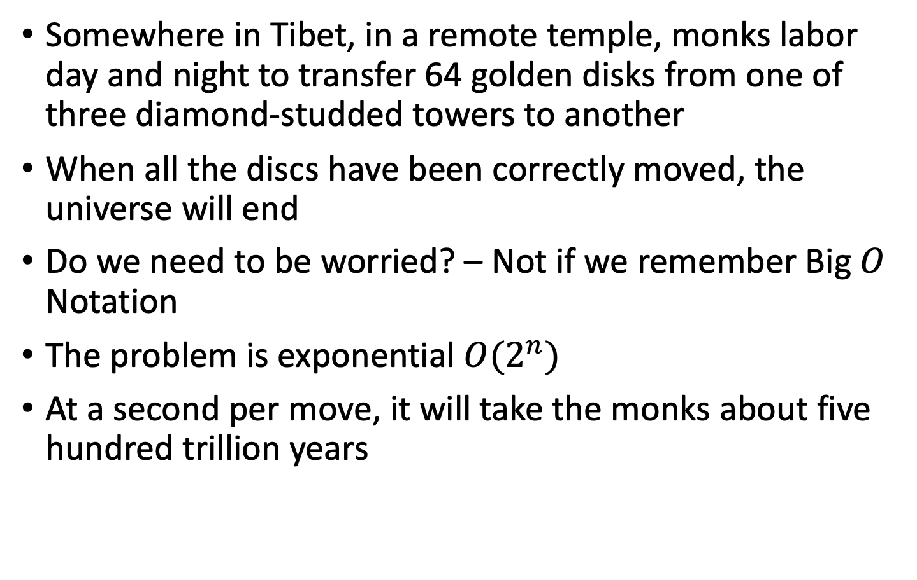
Legend
Somewhere in Tibet, in a remote temple, monks labor day and night to transfer 64 golden disks from one of three diamond-studded towers to another
When all the discs have been correctly moved, the universe will end
Do we need to be worried? – Not if we remember Big $O$ Notation
The problem is exponential $O(2^{n})$
At a second per move, it will take the monks about five hundred trillion years

Slide 33
Recursive Algorithm
Lets call the initial tree-shaped arrangement of disks a tree and the smaller groupings subtrees
In order to transfer 5 disks, one of the intermediate steps involves a subtree of 4 disks
The creation of a subtree is the only way to transfer a larger disk from one tower to another

Slide 34
Recursive Algorithm
We can break the problem into smaller and smaller subtrees
Assuming there are n disks, the algorithm is
1. Move the subtree of the top n-1 disks from source rod to intermediate rod
2. Move the remaining largest disk from source rod to destination rod
3. Now solve moving the subtree from intermediate rod to destination rod
Keep calling the recursive algorithm for moving the smaller subtrees
What’s the base case? When you’re moving only one disk, you just move it, there’s nothing else to do

Slide 35
Java Implementation
public class TowersApp {
static int nDisks = 3;
public static void main(String[] args) {
doTowers(nDisks, 'A', 'B', 'C');
}
public static void doTowers(int topN, char src, char inter, char dest) {
if(topN==1) System.out.println("Disk 1 from " + src + " to "+ dest);
else {
doTowers(topN-1, src, dest, inter); // src to inter
System.out.println("Disk " + topN + " from " + src + " to "+ dest);
// move bottom
doTowers(topN-1, inter, src, dest); // inter to dest
}
}
}

Slide 36
Output
Disk 1 from A to C
Disk 2 from A to B
Disk 1 from C to B
Disk 3 from A to C
Disk 1 from B to A
Disk 2 from B to C
Disk 1 from A to C
How about those monks?
Put nDisks = 64 and what output do you get?

Slide 37
Palindromes
A palindrome is a phrase that reads the same forwards as backwards
You can also think about it as a string whose first half is a mirror image of its second half
“rats live on no evil star”
“ten animals I slam in a net”

Slide 38
Think Recursively
How do we make the problem smaller?
Remove both the first and last characters
Remove a character from the middle
Most promising simplification: remove first and last characters
“AVA", is a palindrome too!
A word is a palindrome if
The first and last characters match, and
Word obtained by removing the first and last characters is a palindrome

Slide 39
Palindromes
If we have a palindrome like radar we can check if the first and last letters are the same
If they are not then it is not a palindrome
We now need to check the middle letters to see if they are a palindrome
Call the recursive method on the middle letters

Slide 40
Palindromes
To pick out the middle letters we can use the substring method
word.substring(1, word.length()-1);
The base case is when we have just one or two letters left and all the other letters have checked out
r a d a r

Slide 41
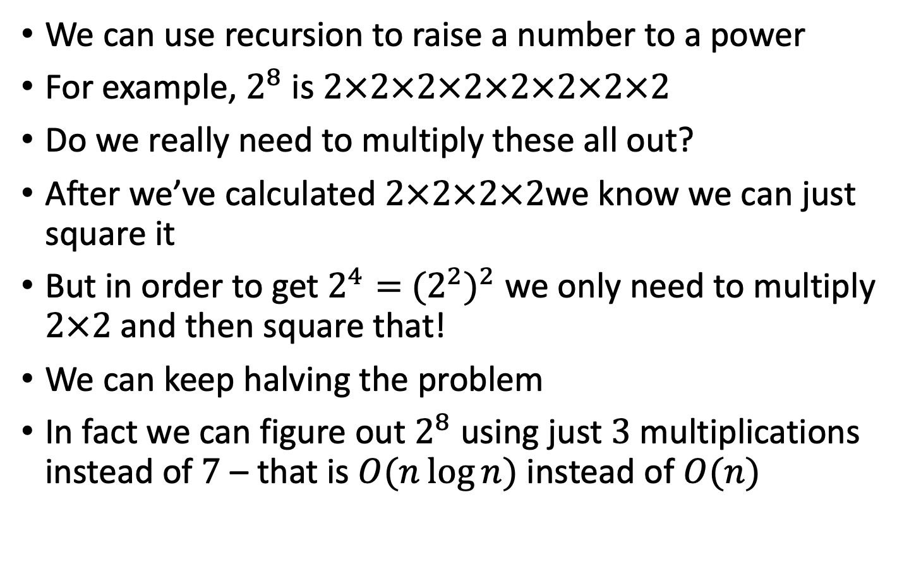
Raising to a power
We can use recursion to raise a number to a power
For example, $2^{8}$ is $2×2×2×2×2×2×2×2$
Do we really need to multiply these all out?
After we’ve calculated $2×2×2×2$we know we can just square it
But in order to get $2^{4}=$ ${(2^{2})}^{2}$ we only need to multiply $2×2$ and then square that!
We can keep halving the problem
In fact we can figure out $2^{8}$ using just $3$ multiplications instead of $7$ – that is $O(n\log{n})$ instead of $O(n)$

Slide 42
Raising to a power
In the previous example, the power was always even, so could be easily divided by two
If the power happens to be odd then we need to subtract one from the power, solve that, and then multiply it again to account for the power we subtracted
Base case is raising to the power of zero
int power(int k, int n) { // raise k to the power n
if (n == 0) return 1;
else{
int t = power(k, n/2); //if odd, will discard remainder
if ((n % 2) == 0) return t * t;
else return k * t * t; //extra multiplication to make up
}
}

Slide 43
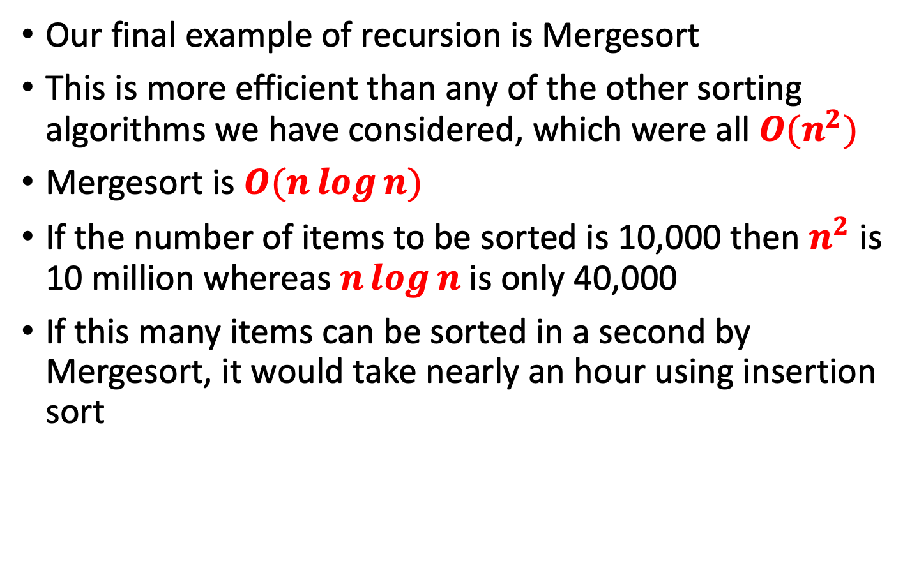
Mergesort
Our final example of recursion is Mergesort
This is more efficient than any of the other sorting algorithms we have considered, which were all $O(n^{2})$
Mergesort is $O(n\log{n})$
If the number of items to be sorted is 10,000 then $n^{2}$ is 10 million whereas $n\log{n}$is only 40,000
If this many items can be sorted in a second by Mergesort, it would take nearly an hour using insertion sort

Slide 44
Merge Sort Example
The idea of mergesort is to divide an array in half and sort each half
They don’t have to be the same size
Both halves are merged into a separate workspace array
Keeps comparing the lowest number in each of the halves before copying one into a workspace array
5
9
10
12
17
1
8
10
20
32

Slide 45
Merge Sort Example
Merge the two sorted arrays into a single sorted array
Merge
Workspace array
5 | 9 | 10 | 12 | 17 |  | 1 | 8 | 11 | 20 | 32
5 | 9 | 10 | 12 | 17 |  | 1 | 8 | 11 | 20 | 32
5 | 9 | 10 | 12 | 17 |  | 1 | 8 | 11 | 20 | 32
5 | 9 | 10 | 12 | 17 |  | 1 | 8 | 11 | 20 | 32
5 | 9 | 10 | 12 | 17 |  | 1 | 8 | 11 | 20 | 32
5 | 9 | 10 | 12 | 17 |  | 1 | 8 | 11 | 20 | 32
5 | 9 | 10 | 12 | 17 |  | 1 | 8 | 11 | 20 | 32
5 | 9 | 10 | 12 | 17 |  | 1 | 8 | 11 | 20 | 32
5 | 9 | 10 | 12 | 17 |  | 1 | 8 | 11 | 20 | 32
5 | 9 | 10 | 12 | 17 |  | 1 | 8 | 11 | 20 | 32
1
1 | 5
1 | 5 | 8
1 | 5 | 8 | 9
1 | 5 | 8 | 9 | 10
1 | 5 | 8 | 9 | 10 | 11
1 | 5 | 8 | 9 | 10 | 11 | 12
1 | 5 | 8 | 9 | 10 | 11 | 12 | 17
1 | 5 | 8 | 9 | 10 | 11 | 12 | 17 | 20
1 | 5 | 8 | 9 | 10 | 11 | 12 | 17 | 20 | 32

Slide 46
How to Merge
Here are two lists to be merged:
First: (12, 16, 17, 20, 21, 27)
Second: (9, 10, 11, 12, 19)
Step 1. Checkout 12 and 9
Because 9 < 12, so move 9 to workspace
First: (12, 16, 17, 20, 21, 27)
Second: (10, 11, 12, 19)
Workspace: (9)
Step 2. Checkout 12 and 10
Because 10 < 12, so move 10 to workspace
First: (12, 16, 17, 20, 21, 27)
Second: (11, 12, 19)
Workspace: (9, 10)

Slide 47
Merge Example
Step 3. Checkout 12 and 11
Because 11 < 12, so move 9 to workspace
First: (12, 16, 17, 20, 21, 27)
Second: (12, 19)
Workspace: (9, 10, 11)
Step 4. Checkout 12 and 12
Because 12 = 12, so move 12 to workspace
We don’t care that you chose which one
First: (16, 17, 20, 21, 27)
Second: (12, 19)
Workspace: (9, 10, 11, 12)

Slide 48
Merge Example
Step 5. Checkout 16 and 12
Because 12 < 16, so move 12 to workspace
First: (16, 17, 20, 21, 27)
Second: (19)
Workspace: (9, 10, 11, 12, 12)
Step 6. Checkout 16 and 19
First: (17, 20, 21, 27)
Second: (19)
Workspace: (9, 10, 11, 12, 12, 16)
Step 7. Checkout 17 and 19
First: (20, 21, 27)
Second: (19)
Workspace: (9, 10, 11, 12, 12, 16, 17)

Slide 49
Merge Example
Step 9. Checkout 20 and 19
First: (20, 21, 27)
Second: ( )
Workspace: (9, 10, 11, 12, 12, 16, 17, 19)
Step 10. Checkout 20 and empty list
Because the First array is empty, we can move all elements of Second to Worksapce
First: ( )
Second: ( )
Workspace: (9, 10, 11, 12, 12, 16, 17, 19, 20, 21, 27)

Slide 50
Analysis of Merge Example
To merge the following lists, we use 10 steps.
First: (12, 16, 17, 20, 21, 27)
Second: (9, 10, 11, 12, 19)
Except one array being empty, we move an element to Workspace at each step
So, if we want to marge any two lists s1 and s2, we need at most s1.length() + s2.length() steps

Slide 51
Java Implementation
In the following merge method
theArray is the array being sorted
first, second and upperBound define the edges of the two halves being sorted. first and second are incremented as items are copied into the workspace
first ➔ second - 1 is the first half
second ➔ upperBound is the second half
workSpace is the intermediate array into which values are copied
The values from workSpace are then copied back into theArray
First half
Second half
5
6
1
7
2
9
4
5
first
second
upperBound

Slide 52
Java Implementation
public void merge(long[] workSpace, int first, int second, int upperBound) {
int j = 0; // workspace index
int lowerBound = first;
int mid = second - 1;
int n = upperBound-lowerBound+1; // # of items
while(first <= mid && second <= upperBound) //halves not empty
if( theArray[first] < theArray[second] )
workSpace[j++] = theArray[first++];
else
workSpace[j++] = theArray[second++];
while(first <= mid) //check first half for remaining
workSpace[j++] = theArray[first++];
while(second <= upperBound) //check second half for remaining
workSpace[j++] = theArray[second++];
for(j = 0; j<n; j++)
theArray[lowerBound+j] = workSpace[j]; //copy the workspace back
} // end merge()

Slide 53
Merge
Merges two areas of an array into a workspace (temporary array)
Copies the workspace back onto original array
First half
Second half
5
6
1
7
2
9
4
5
first
second
upperBound
1
5
6
7
2
9
4
5

Slide 54
recMergeSort method
Computes the midpoint
Calls recMergeSort method on each of the halves
Calls merge method to merge the two sorted halves back together
Base case is when the range contains only one element (lowerBound==upperBound)
A single element is always sorted (obviously!) so it just returns itself

Slide 55
MergeSort
Original | 24 | 13 | 26 | 1 | 12 | 27 | 38 | 15
Divide in 2 | 24 | 13 | 26 | 1 |  | 12 | 27 | 38 | 15
Divide in 4 | 24 | 13 |  | 26 | 1 |  | 12 | 27 |  | 38 | 15
Divide in 8 | 24 |  | 13 |  | 26 |  | 1 |  | 12 |  | 27 |  | 38 |  | 15
Merge 2 | 13 | 24 |  |  | 1 | 26 |  |  | 12 | 27 |  |  | 15 | 38
Merge 4 | 1 | 13 | 24 | 26 |  |  |  |  | 12 | 15 | 27 | 38
Merge 8 | 1 | 12 | 13 | 15 | 24 | 26 | 27 | 38

Slide 56
Execution Example
Partition
7 2 9 4 | 3 8 6 1

Slide 57
Execution Example
7 2 9 4 | 3 8 6 1
Recursive call, partition
7 2 | 9 4

Slide 58
Execution Example
7 2 9 4 | 3 8 6 1
Recursive call, partition
7 2 | 9 4
2 | 7

Slide 59
Execution Example
7 2 9 4 | 3 8 6 1
Recursive call, base case
7 2 | 9 4
7 | 2
7 ➔ 7

Slide 60
Execution Example
7 2 9 4 | 3 8 6 1
Recursive call, base case
7 2 | 9 4
7 | 2
7 ➔ 7
2 ➔ 2

Slide 61
Execution Example
Merge
7 2 9 4 | 3 8 6 1
7 2 | 9 4
7 | 2 ➔ 2 7
7 ➔ 7
2 ➔ 2

Slide 62
Execution Example
Recursive call,
…,
base case,
merge
7 2 9 4 | 3 8 6 1
7 2 | 9 4
7 | 2 ➔ 2 7
9 | 4 ➔ 4 9
7 ➔ 7
2 ➔ 2
7 ➔ 7
2 ➔ 2

Slide 63
Execution Example
Merge
7 2 9 4 | 3 8 6 1
7 2 | 9 4 ➔ 2 4 7 9
7 | 2 ➔ 2 7
9 | 4 ➔ 4 9
7 ➔ 7
2 ➔ 2
7 ➔ 7
2 ➔ 2

Slide 64
Execution Example
Recursive call,
…,
base case,
merge
7 2 9 4 | 3 8 6 1
7 2 | 9 4 ➔ 2 4 7 9
3 8 | 6 1 ➔ 1 3 6 8
7 | 2 ➔ 2 7
9 | 4 ➔ 4 9
3 | 8 ➔ 3 8
6 | 1 ➔ 1 6
7 ➔ 7
2 ➔ 2
7 ➔ 7
2 ➔ 2
7 ➔ 7
2 ➔ 2
7 ➔ 7
2 ➔ 2

Slide 65
Execution Example
Merge
7 2 9 4 | 3 8 6 1 ➔ 1 2 3 4 6 7 8 9
7 2 | 9 4 ➔ 2 4 7 9
3 8 | 6 1 ➔ 1 3 6 8
7 | 2 ➔ 2 7
9 | 4 ➔ 4 9
3 | 8 ➔ 3 8
6 | 1 ➔ 1 6
7 ➔ 7
2 ➔ 2
7 ➔ 7
2 ➔ 2
7 ➔ 7
2 ➔ 2
7 ➔ 7
2 ➔ 2

Slide 66
Java Implementation
public void recMergeSort(long[] workSpace, int lowerBound, int upperBound) {
if(lowerBound == upperBound) // if range is 1,
return; // no use sorting
else { // find midpoint
int mid = (lowerBound+upperBound) / 2; // sort low half
recMergeSort(workSpace, lowerBound, mid); // sort high half
recMergeSort(workSpace, mid+1, upperBound); // merge them
merge(workSpace, lowerBound, mid+1, upperBound);
}
}

Slide 67
MergeSort Alternative Version (2 in 1)
public static void mergeSort(int left, int right) {
int mid = (left + right) /2; // computes midpoint
if(left == right) return; //base case
mergeSort(left, mid);
mergeSort(mid+1, right);
for(int i = left; i <= right; i++)
workSpace[i] = array[i]; //copies entire array into workspace
int i1 = left;
int i2 = mid+1;
for(int curr = left; curr <= right; curr++){ //merge workspace
if(i1>mid){ array[curr] = workSpace[i2++]; } //copies all remnants in
else if(i2>right){array[curr] = workSpace[i1++]; } //copies all remnants in
else if(workSpace[i1] > workSpace[i2]){ array[curr] = workSpace[i1++]; } //merge
else{ array[curr] = workSpace[i2++]; } //merge
}
}
i1
i2
left
mid
right

Slide 68
MergeSort Alternative Version (2 in 1)
int i1 = left;
int i2 = mid+1;
for(int curr = left; curr <= right; curr++){ //merge workspace
if(i1>mid){ array[curr] = workSpace[i2++]; } //copies all remnants in
else if(i2>right){array[curr] = workSpace[i1++]; } //copies all remnants in
else if(workSpace[i1] > workSpace[i2]){ array[curr] = workSpace[i1++]; } //merge
else{ array[curr] = workSpace[i2++]; } //merge
}
This alternative version copies the elements into workspace first and then merges these back into array
i1
i2
left
mid
right

Slide 69
Analyzing the Merge Sort Algorithm
n | Merge Sort (ms) | Selection Sort (ms)
10,000 | 31 | 772
20,000 | 47 | 3,051
30,000 | 62 | 6,846
40,000 | 80 | 12,188
50,000 | 97 | 19,015
60,000 | 113 | 27,359
Merge Sort Timing (blue) versus Selection Sort (red)

Slide 70
Copies and Comparisons
A comparison:
In order to merge the first two cells we need to check is 4 bigger than 1?
A copy:
4
1
6
8
Array
4
1
6
8
Array
Workspace
1

Slide 71
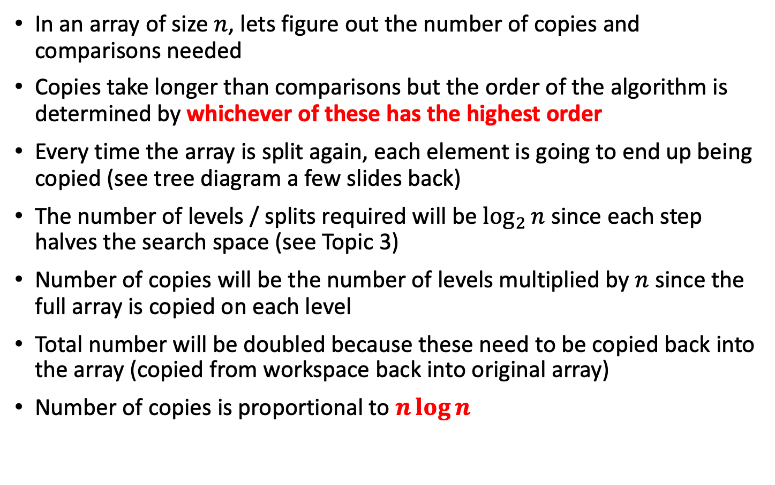
Analyzing the Merge Sort Algorithm
In an array of size $n$, lets figure out the number of copies and comparisons needed
Copies take longer than comparisons but the order of the algorithm is determined by whichever of these has the highest order
Every time the array is split again, each element is going to end up being copied (see tree diagram a few slides back)
The number of levels / splits required will be $\log_{2}{n}$ since each step halves the search space (see Topic 3)
Number of copies will be the number of levels multiplied by $n$ since the full array is copied on each level
Total number will be doubled because these need to be copied back into the array (copied from workspace back into original array)
Number of copies is proportional to $n\log{n}$

Slide 72
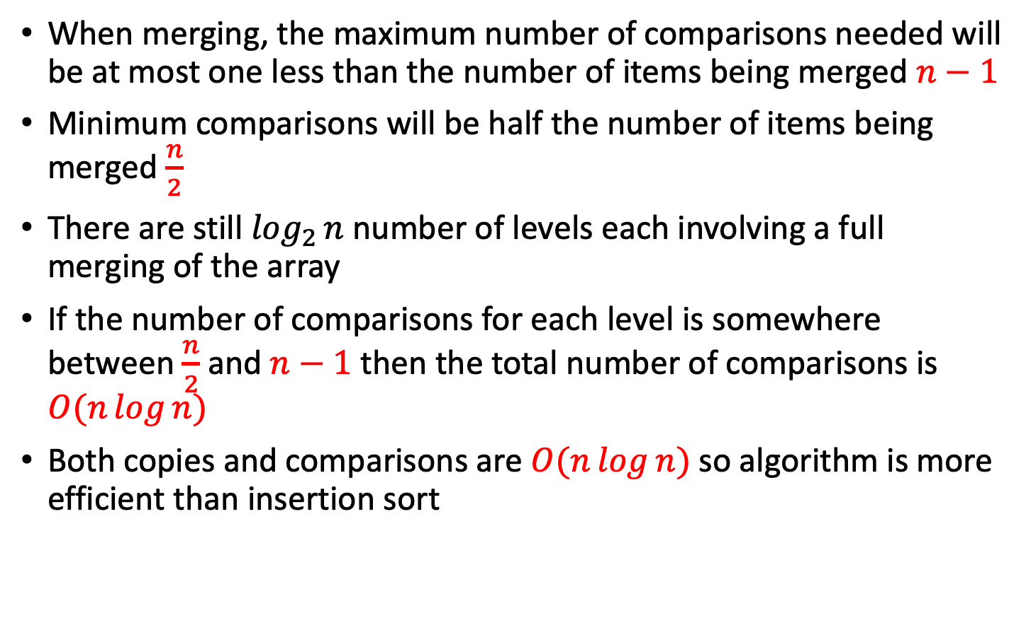
Number of Comparisons
When merging, the maximum number of comparisons needed will be at most one less than the number of items being merged $n−1$
Minimum comparisons will be half the number of items being merged $\frac{n}{2}$
There are still $\log_{2}{n}$ number of levels each involving a full merging of the array
If the number of comparisons for each level is somewhere between $\frac{n}{2}$ and $n−1$ then the total number of comparisons is $O(n\log{n})$
Both copies and comparisons are $O(n\log{n})$so algorithm is more efficient than insertion sort

Slide 73

Worst-Case Scenario: $n−1$
Comparisons
1. 1-3
2. 3-4
3. 4-5
4. 5-6
5. 6-7
6. 7-8
7. 8-9
1
4
6
8
ArrayRight
1
3
4
5
6
7
8
9
3
5
7
9
ArrayLeft

Slide 74

Best-Case Scenario: $\frac{n}{2}$
Comparisons
1. 1-6
2. 3-6
3. 4-6
4. 5-6
1
3
4
5
ArrayRight
1
3
4
5
6
7
8
9
6
7
8
9
ArrayLeft

